Slide 1
Madame scudery project meeting

Slide 2
Today’s Agenda
Analysis of 10 volumes
Two Primary Fonts: Regular and Italic
Title Font (Regular Font, all Caps, Very Large)
Title and Chapter Headers
Tiny Font (Italic or Regular)
Anomalies in Vols 3-10
Progress on Italic Training

Slide 3
Where we are in the grand scheme of things
Do we need to train for other fonts?
Training Italics
Improve WillModule efficiency
Paper
Github
þ

Slide 4
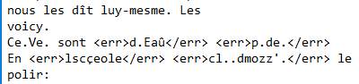
OCR from 2015 - Tiny Font
ImageMagick (IM) damages it too much
Reducing the power of IM may decrease overall accuracy since noise increases
The Tiny Font is rare in body of text
May have to be fixed by French students
1. Original TIFF
3. Final OCR
2. After Image Magick TIFF

Slide 5
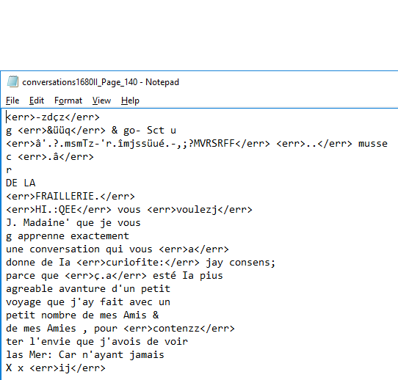
OCR from 2015 - New-Chapter Pages
Image Stuff
“F” added
“P” missing

Slide 6
Margin notes – Con nouv
Most notes are short like Pg 794 above
Unknown how Tesseract will process (Not present in 2015 OCR)
Overall they are rare
About 5 throughout a volume
Pg 849 is an extreme example.

Slide 7
Slanted Pages - entretiens
Some pages are poorly copied
Tesseract may mix up the lines

Slide 8
Ink Bleeding Through - 1688
Not the worst. ImageMagick may clean it up
Pretty bad. Will probably cause issues

Slide 9
What do we do knowing this?
Address these problems in the paper
If they contribute to error rate
Provide analysis of accuracy with/without pages
If we OCR correctly
Show off what it overcame
French students will need to know where the errors are
Keep a log

Slide 10
Progress on Italic Training
Start
Glyphs as TIFF/XML
TIF files
Create Glyphs
(Aletheia)
We are here
Train Tesseract
(Franken+)
Ingest Glyphs and Choose Best Representatives
(Franken+)
Traineddata file
Dictionary files
Font files

Slide 11
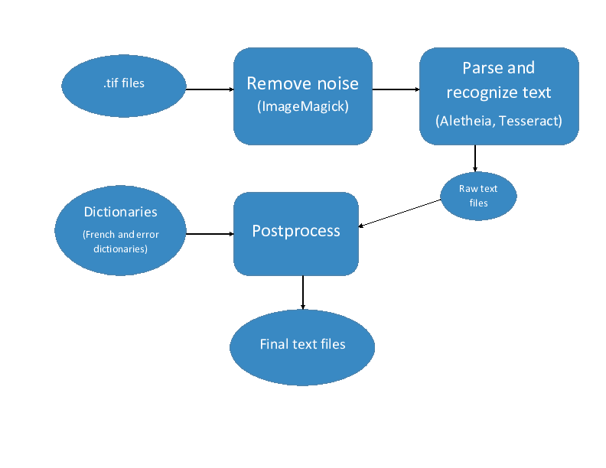
OCR pipeline

